Slide 1
Synthesizing Analytical SQL From Computation Demonstration
MohammadAmin Raeisi
Tehran Institute for Advanced Studies

Slide 2
Overview
Motivation and Problem Statement
Algorithm
Experiments and Results
Recap

Slide 3
Overview
Motivation and Problem Statement
Algorithm
Experiments and Results
Recap

Slide 4




Querying databases with SQL
City | Quarter | Enrolled
A | 1 | 100
A | 2 | 200
A | 3 | 400
How many people enrolled in city A each quarter?
Select City, Quarter, Enrolled
From T
Where City = “A”
City | Quarter | Enrolled
A | 1 | 100
A | 2 | 200
A | 3 | 400
B | 1 | 300
B | 2 | 150
B | 3 | 150
What’s each city’s total enrollment number?
Select City, Sum(Enrolled)
From T
Group By City
City | Sum(Enrolled)
A | 700
B | 600
The total enrollment number at the end of each quarter?
The moving average?
?
Basic SQL is not sufficient for complex analytical tasks
The quarters with highest enrollment number?

Slide 5

Analytical SQL: SQL + Analytical Function
The total enrollment number at the end of each quarter for each city?
Select City,
Quarter,
CumSum(Enrolled) Over (Partition By City)
From T
City | Quarter | Enrolled
A | 1 | 100
A | 2 | 200
A | 3 | 400
B | 1 | 300
B | 2 | 150
B | 3 | 150
City | Quarter | Enrolled
A | 1 | 100
A | 2 | 300
A | 3 | 700
B | 1 | 300
B | 2 | 450
B | 3 | 600
N-th percentile
Lead
Rank
Percentage growth
Percentile count
Programming by Example?
Argmax
Cumulative sum
Moving average
Analytical SQL is a rich and expressive language for analytical tasks
(but it’s also hard to program with)

Slide 6

Synthesizing Analytical SQL from Input-Output Examples?
Find a query q such that q(T) = E
T
City | Quarter | Group | Enrolled | Population
A | 1 | Youth | 1667 | 5668
A | 1 | Adult | 1367 | 5668
A | 2 | Youth | 256 | 5668
A | 2 | Adult | 347 | 5668
A | 3 | Youth | 148 | 5668
A | 3 | Adult | 237 | 5668
A | 4 | Youth | 556 | 5668
A | 4 | Adult | 432 | 5668
B | 1 | Youth | 2578 | 10541
B | 1 | Adult | 1000 | 10541
… | … | … | … | …
E
City | Quarter | Percentage
A | 1 | 53.5%
A | 2 | 64.1%
A | 3 | 70.9%
A | 4 | 88.3%
B | 1 | 33.9%
… | … | …
?

Slide 7
Synthesizing Analytical SQL from Input-Output Examples?
Task: calculate the percentage of cumulative enrollment over city population
City | Quarter | Total | Population
A | 1 | 3034 | 5668
A | 2 | 603 | 5668
A | 3 | 385 | 5668
A | 4 | 988 | 5668
B | 1 | 3578 | 10541
… | … |  | …
Partition by
City
City | Quarter | Group | Enrolled | Population
A | 1 | Youth | 1667 | 5668
A | 1 | Adult | 1367 | 5668
A | 2 | Youth | 256 | 5668
A | 2 | Adult | 347 | 5668
A | 3 | Youth | 148 | 5668
A | 3 | Adult | 237 | 5668
A | 4 | Youth | 556 | 5668
A | 4 | Adult | 432 | 5668
B | 1 | Youth | 2578 | 10541
B | 1 | Adult | 1000 | 10541
… | … | … | … | …
Group by
City, Quarter
CumSum(Total)
Sum(Enrolled)
City | Quarter | CumSum | Population
A | 1 | 3034 | 5668
A | 2 | 3637 | 5668
A | 3 | 4022 | 5668
A | 4 | 5010 | 5668
B | 1 | 3578 | 10541
… | … |  | …
City | Quarter | Percentage
A | 1 | 53.5%
A | 2 | 64.1%
A | 3 | 70.9%
A | 4 | 88.3%
B | 1 | 33.9%
… | … | …
CumSum / Population * 100%

Slide 8



Synthesizing Analytical SQL from Input-Output Examples?
Problem 1: creating the example requires a lot of manual calculation, and it is error-prone
City | Quarter | Group | Enrolled | Population
A | 1 | Youth | 1667 | 5668
A | 1 | Adult | 1367 | 5668
A | 2 | Youth | 256 | 5668
A | 2 | Adult | 347 | 5668
A | 3 | Youth | 148 | 5668
A | 3 | Adult | 237 | 5668
A | 4 | Youth | 556 | 5668
A | 4 | Adult | 432 | 5668
B | 1 | Youth | 2578 | 10541
B | 1 | Adult | 1000 | 10541
… | … | … | … | …
City | Quarter | Percentage
A | 1 | 53.5%
A | 2 | 64.1%
A | 3 | 70.9%
A | 4 | 88.3%
B | 1 | 33.9%
… | … | …
?
Problem 2: The example hides user intent, making the task ambiguous and hard to solve

Slide 9
Overview
Motivation and Problem Statement
Algorithm
Experiments and Results
Recap

Slide 10
Synthesizing Analytical SQL from Input-Output Examples
City | Quarter | Group | Enrolled | Population
A | 1 | Youth | 1667 | 5668
A | 1 | Adult | 1367 | 5668
A | 2 | Youth | 256 | 5668
A | 2 | Adult | 347 | 5668
A | 3 | Youth | 148 | 5668
A | 3 | Adult | 237 | 5668
A | 4 | Youth | 556 | 5668
A | 4 | Adult | 432 | 5668
B | 1 | Youth | 2578 | 10541
B | 1 | Adult | 1000 | 10541
… | … | … | … | …
(1677 + … + 237) / 5668 * 100%
City | Quarter | Percentage
A | 1 | 53.5%
A | 2 | 64.1%
A | 3 | 70.9%
A | 4 | 88.3%
B | 1 | 33.9%
… | … | …
Key: let the user demonstrate the computation process, not just the final value

Slide 11
Synthesizing Analytical SQL from Input-Output Examples
Computation Demonstration
Design 1: demonstrate the computation using cell-level expressions
City | Quarter | Group | Enrolled | Population
A | 1 | Youth | 1667 | 5668
A | 1 | Adult | 1367 | 5668
A | 2 | Youth | 256 | 5668
A | 2 | Adult | 347 | 5668
A | 3 | Youth | 148 | 5668
A | 3 | Adult | 237 | 5668
A | 4 | Youth | 556 | 5668
A | 4 | Adult | 432 | 5668
B | 1 | Youth | 2578 | 10541
B | 1 | Adult | 1000 | 10541
… | … | … | … | …
City | Quarter | Percentage
A | 1 | (1667 + 1367) / 5668 * 100%
A | 4 | (1667 + … + 432) / 5668 * 100%
B | 1 | (2578 + 1000) / 10541 * 100%
Design 3: support incomplete expressions
Design 2: support partial output table – not all rows needs to be provided

Slide 12
Synthesis Criteria for Computation Demonstration
T
City | Quarter | Group | Enrolled | Population
A | 1 | Youth | 1667 | 5668
A | 1 | Adult | 1367 | 5668
A | 2 | Youth | 256 | 5668
A | 2 | Adult | 347 | 5668
A | 3 | Youth | 148 | 5668
A | 3 | Adult | 237 | 5668
A | 4 | Youth | 556 | 5668
A | 4 | Adult | 432 | 5668
B | 1 | Youth | 2578 | 10541
B | 1 | Adult | 1000 | 10541
… | … | … | … | …
Programming by Example
Given T and E, find q such that exists q(T) = E
1. Tracking of how each cell in q(T) is computed
Computation Demonstration
Given T and E, find q such that q(T) is computationally consistent with E
2. Capturing the fact that E can be partial
q(T)
3. Handling incomplete expressions
e.g., (1 + 2 + 3 + 4) generalizes (1 + … + 4)
City | Quarter | Percentage
A | 1 | (1667 + 1367) / 5668 * 100%
A | 2 | (1667 + 1367 + 256 + 347) / 5668 * 100%
A | 3 | (1667 + 1367 + 256 + 347 + 148 + 237) / 5668 * 100%
A | 4 | (1667 + 1367 + 256 + 347 + 148 + 237 + 556 + 432) / 5668 * 100%
B | 1 | (2578 + 1000) / 10541 * 100%
E
City | Quarter | Percentage
A | 1 | (1667 + 1367) / 5668 * 100%
A | 4 | (1667 + … + 432) / 5668 * 100%
B | 1 | (2578 + 1000) / 10541 * 100%

Slide 13
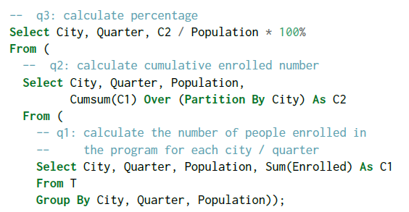
Query Representation
T
City | Quarter | Group | Enrolled | Population
A | 1 | Youth | 1667 | 5668
A | 1 | Adult | 1367 | 5668
A | 2 | Youth | 256 | 5668
A | 2 | Adult | 347 | 5668
A | 3 | Youth | 148 | 5668
A | 3 | Adult | 237 | 5668
A | 4 | Youth | 556 | 5668
A | 4 | Adult | 432 | 5668
B | 1 | Youth | 2578 | 10541
B | 1 | Adult | 1000 | 10541
… | … | … | … | …
E
t1 ← group(T, [City, Quarter, Population], sum, Enrolled)
t2 ← partition(t1, [City], cumsum, C1)
t3 ← arithmetic(t2, λx, y. x/y * 100%, [C2, Population])
City | Quarter | Percentage
A | 1 | (1667 + 1367) / 5668 * 100%
A | 4 | (1667 + … + 432) / 5668 * 100%
B | 1 | (2578 + 1000) / 10541 * 100%

Slide 14
Synthesis Algorithm: Enumerative Search with Abstraction-based Pruning
Operators: group, partition, arithmetic
t1 ← group(T, [City, Quarter, Population], □, □)
t2 ← arithmetic(t1, □, □)
t1 ← group(T, [City], □, □)
T
……
t1 ← group(T, □, □, □)
City | Quarter | Group | Enrolled | Population
A | 1 | Youth | 1667 | 5668
A | 1 | Adult | 1367 | 5668
A | 2 | Youth | 256 | 5668
A | 2 | Adult | 347 | 5668
A | 3 | Youth | 148 | 5668
A | 3 | Adult | 237 | 5668
A | 4 | Youth | 556 | 5668
A | 4 | Adult | 432 | 5668
B | 1 | Youth | 2578 | 10541
B | 1 | Adult | 1000 | 10541
… | … | … | … | …
t1 ← partition(T, [City], □, □)
City | Quarter | Percentage
A | 1 | (1667 + 1367) / 5668 * 100%
A | 2 | (1667 + 1367 + 256 + 347) / 5668 * 100%
A | 3 | (1667 + 1367 + 256 + 347 + 148 + 237) / 5668 * 100%
A | 4 | (1667 + 1367 + 256 + 347 + 148 + 237 + 556 + 432) / 5668 * 100%
B | 1 | (2578 + 1000) / 10541 * 100%
… | … | …
t1 ← partition(T, □, □, □)
t1 ← group(T, [City, Quarter], □, □)
t2 ← arithmetic(t1, □, □)
……
t1 ← group(T, □, □, □)
t2 ← arithmetic(t1, □, □)
t1 ← group(T, [Quarter], □, □)
t2 ← arithmetic(t1, □, □)
t1 ← partition(T, □, □, □)
t2 ← arithmetic(t1, □, □)
t1 ← group(T, [City, Quarter], □, □)
t2 ← partition(t1, □, □, □)
t3 ← arithmetic(t2, □, □)
……
t1 ← group(T, □, □, □)
t2 ← partition(t1, □, □, □)
t3 ← arithmetic(t2, □, □)
t1 ← group(T, [City, Quarter, Population], □, □)
t2 ← partition(t1, □, □, □)
t3 ← arithmetic(t2, □, □)
E
……
t1 ← group(T, [City, Quarter, Population], sum, Enrolled)
t2 ← partition(t1, [City], cumsum, C1)
t3 ← arithmetic(t2, λx, y. x/y * 100%, [C2, Population])
City | Quarter | Percentage
A | 1 | (1667 + 1367) / 5668 * 100%
A | 4 | (1667 + … + 432) / 5668 * 100%
B | 1 | (2578 + 1000) / 10541 * 100%
t1 ← group(T, [City, Quarter, Population], sum, Enrolled)
t2 ← partition(t1, [City], sum, C1)
t3 ← arithmetic(t2, □, □)
……

Slide 15
Synthesis Algorithm: Enumerative Search with Abstraction-based Pruning
Looks incorrect, how can we tell?
Operators: group, partition, arithmetic
t1 ← group(T, [City, Quarter, Population], □, □)
t2 ← arithmetic(t1, □, □)
t1 ← group(T, [City], □, □)
T
……
Type: the output has only 2 columns, not 3!
t1 ← group(T, □, □, □)
City | Quarter | Group | Enrolled | Population
A | 1 | Youth | 1667 | 5668
A | 1 | Adult | 1367 | 5668
A | 2 | Youth | 256 | 5668
A | 2 | Adult | 347 | 5668
A | 3 | Youth | 148 | 5668
A | 3 | Adult | 237 | 5668
A | 4 | Youth | 556 | 5668
A | 4 | Adult | 432 | 5668
B | 1 | Youth | 2578 | 10541
B | 1 | Adult | 1000 | 10541
… | … | … | … | …
t1 ← partition(T, [City], □, □)
City | Quarter | Percentage
A | 1 | (1667 + 1367) / 5668 * 100%
A | 2 | (1667 + 1367 + 256 + 347) / 5668 * 100%
A | 3 | (1667 + 1367 + 256 + 347 + 148 + 237) / 5668 * 100%
A | 4 | (1667 + 1367 + 256 + 347 + 148 + 237 + 556 + 432) / 5668 * 100%
B | 1 | (2578 + 1000) / 10541 * 100%
… | … | …
t1 ← partition(T, □, □, □)
t1 ← group(T, [City, Quarter], □, □)
t2 ← arithmetic(t1, □, □)
……
t1 ← group(T, □, □, □)
t2 ← arithmetic(t1, □, □)
t1 ← group(T, [Quarter], □, □)
t2 ← arithmetic(t1, □, □)
t1 ← partition(T, □, □, □)
t2 ← arithmetic(t1, □, □)
t1 ← group(T, [City, Quarter], □, □)
t2 ← partition(t1, □, □, □)
t3 ← arithmetic(t2, □, □)
Value: the output can not produce values “A”, “B” required by E!
……
t1 ← group(T, □, □, □)
t2 ← partition(t1, □, □, □)
t3 ← arithmetic(t2, □, □)
t1 ← group(T, [City, Quarter, Population], □, □)
t2 ← partition(t1, □, □, □)
t3 ← arithmetic(t2, □, □)
E
……
t1 ← group(T, [City, Quarter, Population], sum, Enrolled)
t2 ← partition(t1, [City], cumsum, C1)
t3 ← arithmetic(t2, λx, y. x/y * 100%, [C2, Population])
City | Quarter | Percentage
A | 1 | (1667 + 1367) / 5668 * 100%
A | 4 | (1667 + … + 432) / 5668 * 100%
B | 1 | (2578 + 1000) / 10541 * 100%
t1 ← group(T, [City, Quarter, Population], sum, Enrolled)
t2 ← partition(t1, [City], sum, C1)
t3 ← arithmetic(t2, □, □)
……

Slide 16

Pruning with Abstract Provenance Analysis
q
t1 ← group(T, [City, Quarter, Population], □, □)
t2 ← arithmetic(t1, □, □)
T
City | Quarter | Group | Enrolled | Population
A | 1 | Youth | 1667 | 5668
A | 1 | Adult | 1367 | 5668
A | 2 | Youth | 256 | 5668
A | 2 | Adult | 347 | 5668
A | 3 | Youth | 148 | 5668
A | 3 | Adult | 237 | 5668
A | 4 | Youth | 556 | 5668
A | 4 | Adult | 432 | 5668
B | 1 | Youth | 2578 | 10541
B | 1 | Adult | 1000 | 10541
… | … | … | … | …
City | Quarter | Population | Aggregated Value
A | 1 | 5668 | {Youth, 1667, Adult, 1367}
A | 2 | 5668 | {Youth, 256, Adult, 347}
A | 3 | 5668 | {Youth, 148, Adult, 237}
A | 4 | 5668 | {Youth, 556, Adult, 432}
B | 1 | 10541 | {Youth, 2578, Adult, 1000}
… | … | … | …
Observation
E demonstrates how values in T flows to E.
group
Let’s analyze if q(T)’s data provenance (flow) is consistent with E
q(T)
arithmetic
City | Quarter | Population | Aggregated Value | Arithmetic Output
A | 1 | 5668 | {Youth, 1667, Adult, 1367} | {A, 1, 5668, Youth, 1667, Adult, 1367}
A | 2 | 5668 | {Youth, 256, Adult, 347} | {A, 2, 5668, Youth, 256, Adult, 347}
A | 3 | 5668 | {Youth, 148, Adult, 237} | {A, 3, 5668, Youth, 148, Adult, 237}
A | 4 | 5668 | {Youth, 556, Adult, 432} | {A, 4, 5668, Youth, 556, Adult, 432}
B | 1 | 10541 | {Youth, 2578, Adult, 1000} | {B, 1, 10541, Youth, 2578, Adult, 1000}
… | … | … | …
E
Over-approximates data provenance
City | Quarter | Percentage
A | 1 | (1667 + 1367) / 5668 * 100%
A | 4 | (1667 + … + 432) / 5668 * 100%
B | 1 | (2578 + 1000) / 10541 * 100%
Contradiction! q(T) does not allow 1667 to flow into the arithmetic output for city A quarter 4!

Slide 17
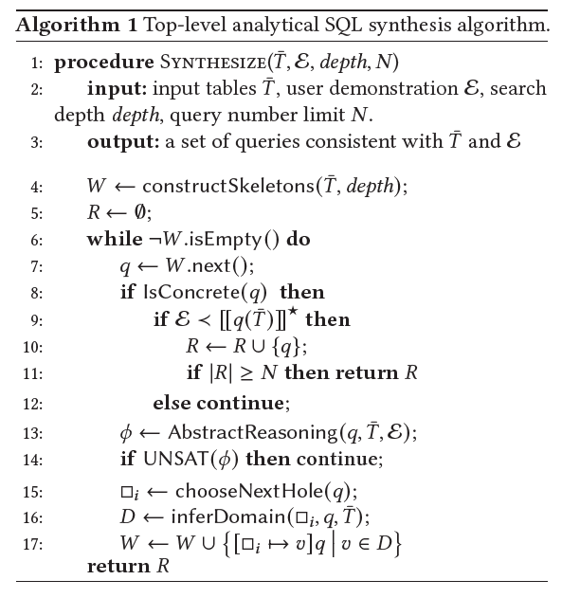
Synthesizing Analytical SQL from Computation Demonstration
City | Quarter | Percentage
A | 1 | (1667 + 1367) / 5668 * 100%
A | 2 | (1667 + 1367 + 256 + 347) / 5668 * 100%
A | 3 | (1667 + 1367 + 256 + 347 + 148 + 237) / 5668 * 100%
A | 4 | (1667 + 1367 + 256 + 347 + 148 + 237 + 556 + 432) / 5668 * 100%
B | 1 | (2578 + 1000) / 10541 * 100%
… | … | …
t1 ← partition(T, □, □, □)
t1 ← group(T, □, □, □)
t2 ← arithmetic(t1, □, □)
t1 ← group(T, [City, Quarter, Population], sum, Enrolled)
t2 ← partition(t1, [City], cumsum, C1)
t3 ← arithmetic(t2, λx, y. x/y * 100%, [C2, Population])
t1 ← group(T, □, □, □)
t2 ← partition(t1, □, □, □)
t3 ← arithmetic(t2, □, □)
City | Quarter | Percentage
A | 1 | (1667 + 1367) / 5668 * 100%
A | 4 | (1667 + … + 432) / 5668 * 100%
B | 1 | (2578 + 1000) / 10541 * 100%
Pruning with Abstract Provenance Analysis

Slide 18
Overview
Motivation and Problem Statement
Algorithm
Experiments and Results
Recap

Slide 19
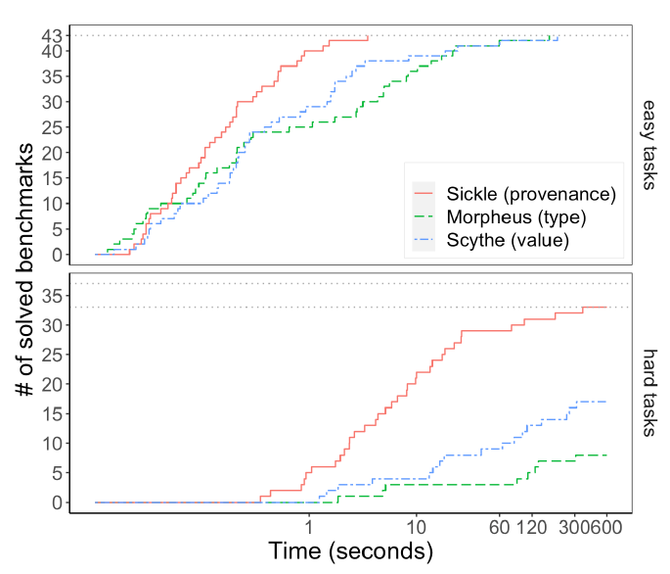
Experiment: Synthesis Efficiency
Observation 1:
Sickle is slightly faster on easier task
Benchmarks
60 online posts + 20 queries extracted from TPC-DS
43 easy (1-3 operators)
37 hard (4-6 operators)
Pruning Abstraction
Type, Value, Provenance
Observation 2: Sickle is faster and solve much more hard tasks!
Setup
Demonstration generated by sampling from query output

Slide 20
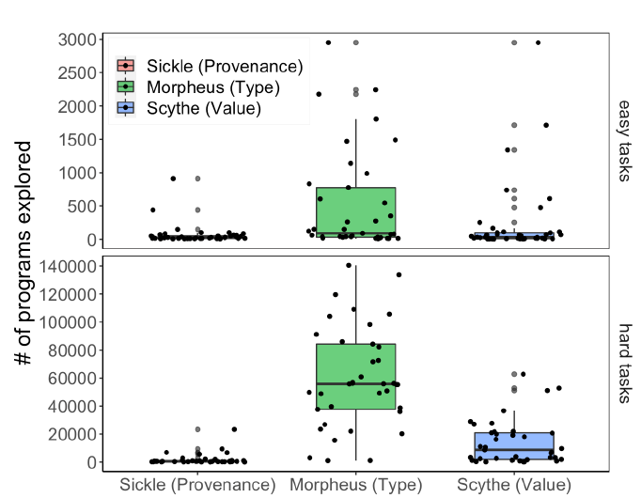
Experiment: Number of Queries Visited
Observation 3:
Provenance abstraction significantly reduces programs to be visited

Slide 21
User Experience Study: 6 analytical tasks with 13 participants
User Specification Method
Concrete values (PBE)
Computation demonstration without partial expression
Computation demonstration
Computation demonstration:
Is faster to create for harder tasks, slower for easier tasks
Increases user confidence
Does not suit all operators (RANK, COUNT)
Partial expression
Reduces spec effort
Some participants find it hard to master

Slide 22
Overview
Motivation and Problem Statement
Algorithm
Experiments and Results
Recap

Slide 23

Recap
P1. require a lot of manual calculation and it is error-prone
P2. make the task ambiguous and hard to solve
design new specifications for better user-synthesizer communication
T
City | Quarter | Group | Enrolled | Population
A | 1 | Youth | 1667 | 5668
A | 1 | Adult | 1367 | 5668
A | 2 | Youth | 256 | 5668
A | 2 | Adult | 347 | 5668
A | 3 | Youth | 148 | 5668
A | 3 | Adult | 237 | 5668
A | 4 | Youth | 556 | 5668
A | 4 | Adult | 432 | 5668
B | 1 | Youth | 2578 | 10541
B | 1 | Adult | 1000 | 10541
… | … | … | … | …
City | Quarter | Percentage
A | 1 | 53.5%
A | 2 | 64.1%
A | 3 | 70.9%
A | 4 | 88.3%
B | 1 | 33.9%
… | … | …
Enumerative search
Pruning with abstract provenance analysis
Find q such that q(T) is computationally consistent with E
E
t1 ← group(T, [City, Quarter, Population], sum, Enrolled)
t2 ← partition(t1, [City], cumsum, C1)
t3 ← arithmetic(t2, λx, y. x/y * 100%, [C2, Population])
City | Quarter | Percentage
A | 1 | (1667 + 1367) / 5668 * 100%
A | 4 | (1667 + … + 432) / 5668 * 100%
B | 1 | (2578 + 1000) / 10541 * 100%

Slide 24
Thank You!

